Slide 1
Analyzing Data
Examine Data
Explore the Underlying Distribution of Data
Use Visualizations to Analyze Data
Preprocess Data

Slide 2

Examine Data

Slide 3






You Are Here (Analyze)
Frame the Problem
Identify & Collect Data
Process Data
Analyze Data
Finalize the Project
Train Models

Slide 4
Exploratory Data Analysis
Exploratory data analysis: A data science approach to closely examining data in order to reveal new information.
Purpose is to maximize insights gleaned from the data.
Objectives:
Test and evaluate prior assumptions.
Reveal underlying data structure.
Determine important features/factors.
Identify unwanted elements.
Determine best path forward.
EDA is flexible and often employs visualizations.
Enables more open-ended exploration.
Incorporates plots of raw data and summarized data.
Arranging multiple plots can make it easier to recognize patterns.
EDA is valuable at every step of the process.
Changing the data or applying it could prompt EDA.

Slide 5
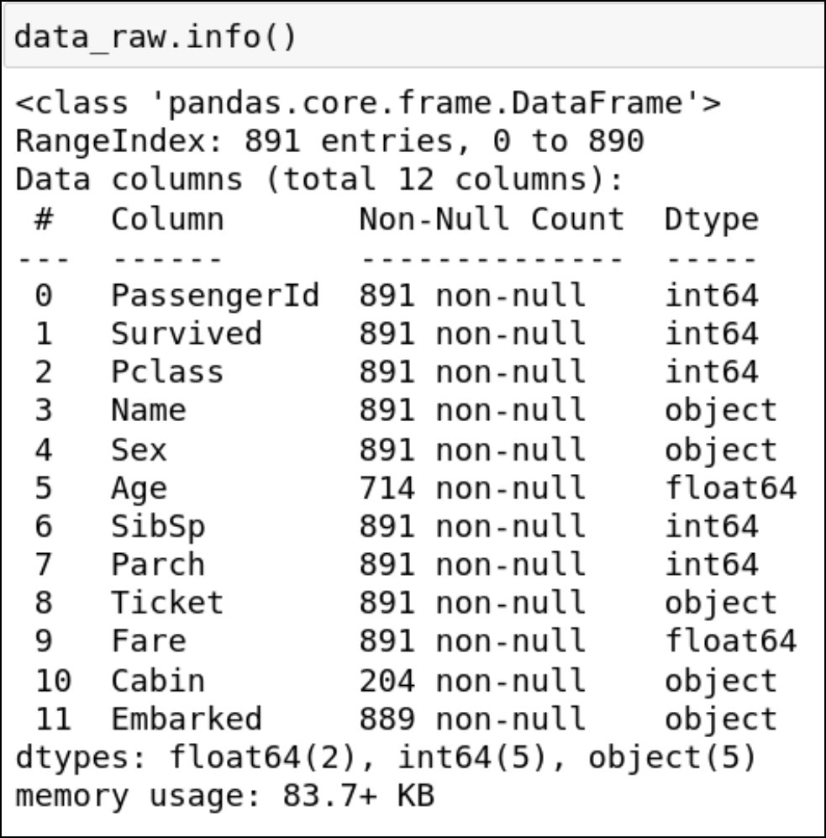
Dataset Content and Format
Start by getting familiar with content and format of data.
Try to identify:
Number of columns
Names of columns
Data types of columns
Number of rows
Primary row identifiers
Value representation
Presence/number of missing values
Use Python DataFrame functions:
info() to get attributes.
head() to get first few rows.

Slide 6
Analysis of Feature Types
You can easily identify data types, but feature types can be more difficult.
Example: color feature.
Formatted as integer.
Values are 1, 2, 3, or 4.
Looks ordinal or quantitative to a machine.
However, it's been encoded with arbitrary numbers that map to color names.
So it's actually categorical.
If features are descriptive enough, you may be able to guess their type.
Or, prior domain knowledge can make you certain.
You might not have either advantage.
Analyze features closely to determine feature types.
Relate unknown features to known features.
Look for other clues, like strings that all contain decimals.
No fool-proof way to determine feature type; use critical thinking and review data thoroughly.

Slide 7
Target Features
Target feature: The variable you're interested in learning more about.
Variable you're trying to predict, categorize, etc.
The label in a supervised dataset is a target feature.
It may not always be clear what the target feature(s) should be.
A thorough understanding of the business problem and dataset will help you choose.
Example: Determine how to allocate computing resources for servers.
Candidate target features: server uptime, dropped connections, FLOPS, etc.
Measure performance in different ways.
Improving performance is the whole point.
Consider researching similar real-world cases for ideas.
Take into account the type of model you want to build.
E.g., building a classifier means choosing a categorical variable as a target feature.

Slide 8
Feature Relevance
You still need to consider how relevant features are to the problem at hand.
Example: age might seem to be a great predictor of income.
There may be subtleties that your assumptions don't account for.
Some features are more or less relevant than others.
You might end up removing or changing features that you deem irrelevant.
Irrelevant features can impact the usefulness of your model.
Domain knowledge can help you identify feature relevance, but only so much.
Relationships between variables is what you're trying to study.
A machine might be estimating this relationship for you.
Don't pack datasets full of features unless there’s a good reason.
Can negatively impact results if there are too many irrelevant features.

Slide 9
Representative Data
Representative sample data approximates characteristics of the wider population.
Example: General retailer who surveys 40 customers.
32 female, 8 male.
If your total customer base is split 50/50, this is not representative.
Results can be negatively impacted.
Sample size may also lead to unrepresentative data.
40 may be too few to capture the variety of demographics.
There are still limits to representative sampling.
There needs to be at least some common ground.
Stratified random sampling:
Key groups are identified.
Members are placed into groups (strata).
Within each stratum, random members are chosen.
All are compiled into one sample.
Look for categorical features that are potentially key strata.
Check if data examples proportionally represent these strata from the population.
Proportion is not always evenly split.
Proportions are not always known in the population.

Slide 10
Additional Sampling Techniques
Random oversampling
Values selected at random with replacement to add to new dataset.
Data from minority class can be duplicated multiple times.
No new information.
Random undersampling
Data examples from majority class are removed to achieve balance.
Might remove useful examples.
Synthetic minority oversampling technique (SMOTE)
Creates non-naturally observed data examples.
Synthetic data generated by selecting location close by in feature space to existing data.
Addresses problem of lack of new data in random oversampling.

Slide 11
Imbalanced Datasets
A dataset that has a disproportional frequency of each value in a categorical variable.
Usually the target variable.
Example: Dataset of people and their handedness.
90% of the world is right handed, 10% is left.
Even though sample might be representative, there's still an imbalance.
Imbalance can make it hard for a model to learn patterns.
Less of a problem when there is a natural imbalance in a population.
Example: Redundant storage being written to.
Timestamps classified as either 0 (yes) or 1 (no).
Most in your sample are labeled class 0.
You might have no idea what the population is like.
Model might not perform well with future data.
Some evaluation metrics are better for imbalanced datasets.
You should identify the frequency of all data examples that belong to each class.
Easy to do numerically or visually.

Slide 12
Errors, Outliers, and Noise
Issue | Description | How to Identify
Errors | Incorrect or missing values. Model can fail to learn patterns or learn wrong patterns. | Incorrect values can be difficult to identify, unless obvious. Missing values are easier to spot.
Outliers | Values outside dataset's main distribution. Result of mistakes in observation or can occur naturally. Cause problems with pattern recognition. | Graphs can visually depict outliers. They will fall outside the main group.
Noise | Makes it difficult for model to "hear" patterns. Unnecessary for estimation, or hinders estimation. Adds to complexity of analysis and model creation. | Several techniques for identifying unnecessary complexities in datasets. In some cases you can see the lack of a pattern using a graph.

Slide 13
Correlations
Correlation: A mathematical association between two variables.
Suggests variables have an effect on each other.
Nature of effect can vary.
Data analysis/machine learning approaches look for correlations.
Can enhance predictive and decision-making abilities.
Example: Predicting the rise and fall of city population.
Potential correlation between job_availability and total_population.
More jobs may lead to larger populations.
Correlation isn't always perfect.
Model does a better job of predicting future population based on job availability.
Correlation does not necessarily imply causation.
Other variables/factors can have an effect.
Cause/effect may be reversed.
Does increase in jobs lead to larger populations, or vice versa?
Think critically when it comes to correlations and don't jump to conclusions.

Slide 14
Correlation Coefficient
Pearson correlation coefficient: A measurement of the linear correlation between two variables commonly called x and y.
Produces a value between +1 (positive correlation) and −1 (negative correlation).
Shows the strength of their dependence on each other.
Positive Correlation
No Correlation
Negative Correlation
r = 0.6
r = 0
r = −0.8

Slide 15
Correlation Strength
Strong Positive Correlation
Strong Negative Correlation
Weak Positive Correlation
Weak Negative Correlation

Slide 16
Guidelines for Examining Data
Spend a fair bit of time interacting with the data you will be working with.
Use charts to begin to understand the data, but don't rely too heavily on them.
Use multiple charts of different fields to determine correlation between these fields.
Examine a number of small portions of a dataset to understand relationships.
Resist the urge to start drawing conclusions from the data without a thorough manual review.
Bring the data into a data science tool or even Excel for ad hoc searching and plotting.

Slide 17
Examining Data

Slide 18
Explore the Underlying Distribution of Data

Slide 19
Frequency Distribution (Fruit Example)

Slide 20
Frequency Distribution (Height Example)

Slide 21
Probability Distribution (Fruit Example)

Slide 22
Probability Distribution (Height Example)

Slide 23
Normal Distribution
Bell shaped
Symmetrical
Centered
Unimodal
Frequency or Probability
Variable Values

Slide 24
Normal Distribution (Height Example)

Slide 25
Non-Normal Distributions
Skewed Distributions
Multi-Modal Distributions

Slide 26
Descriptive Statistical Analysis
Descriptive statistical analysis: A method of quantitively summarizing relationships in data using mathematics and visualizations.
Descriptive statistics are also called summary statistics.
Provides insights that will:
Help you improve the dataset's usefulness in various data science tasks.
Lead to more effective statistical models.
Concepts described through descriptive statistics include:
Central tendency
Variability
Variance
Standard deviation
Skewness
Kurtosis

Slide 27
Central Tendency
Measures concerned with what's going on in the middle of the dataset.
Example set: [10, 10, 10, 24, 28, 38, 62]
Mean:
Simple average of all numbers in the set.
Calculated by adding all numbers, then dividing by the total count.
Example: Mean is 26.
Median:
The number value located in the middle of a sorted set.
Example: Median is 24.
Mode:
The number that occurs most often within a set of numbers.
Example: Mode is 10.
Perfect normal distribution has same value for mean, median, and mode.
Measures are still useful since many datasets do not follow perfect normal distribution.

Slide 28
When to Use Different Measures of Central Tendency
Measure | Most Useful for Describing
Mean | Continuous data in a symmetrical distribution with no outliers.
Median | Distributions that are skewed or that have outliers.
Mode | Qualitative/categorical data from a limited set.

Slide 29
Variability
Variability: The extent to which data varies across all values in a dataset.
Also called dispersion, scatter, or spread.
Lets you know whether distribution is stretched out widely among a range of values or condensed among very similar values.
Common measures:
Interquartile range
Variance
Standard deviation

Slide 30
Range Measures
Median
25% of the data values occur within each quartile
Q1
Q2
Q3
Q4
Interquartile Range
The middle 50% of data values

Slide 31
Variance and Standard Deviation
You might need to compare the variability of datasets containing different numbers of samples or datasets with a different central tendency.
To be most useful, a measure of variability:
Is dependent on the amount of variability in the data.
Is not dependent on:
The number of samples in the data.
The central tendency of the data.
Both variance and standard deviation meet these requirements.

Slide 32

Calculation of Variance
$$σ^{2}=\frac{\sum{{\left(X−μ\right)}^{2}}}{N}$$
Variance of a population—Measures how far each value in the dataset is from the mean.
Where:
σ² represents variance of a population.
Σ is the summation operator, meaning "add the following numbers."
X is the quantity measured in the data, such as sales per rep or the number of prospects.
μ is the mean, the average of all of the values in the set.
N is the number of values included in the set.
Calculated for a column of data by:
Finding the mean (average) of all values in the set.
For each number in the set, subtracting the mean and then squaring the difference.
Adding up all of the values you calculated in step 2, and dividing by the number of values in the set to get the average.
Provides two benefits by squaring the difference (step 2):
Gives more weight to values farther away from the mean.
Ensures that numbers less than the mean won't cancel out numbers greater than the mean.
Values that are less than the mean or greater than the mean will both have a positive influence on the measure of variance.

Slide 33

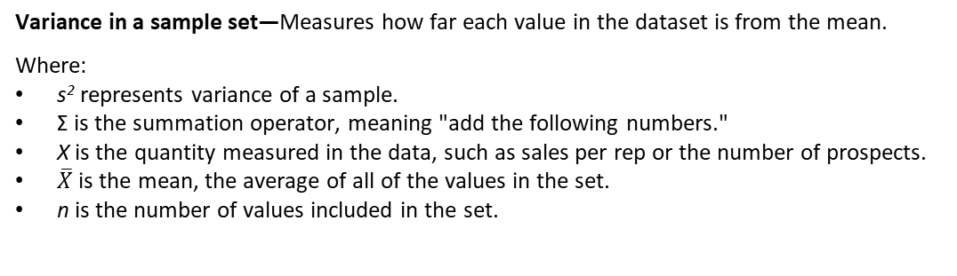
Variance in a Sample Set
$$s^{2}=\frac{\sum{{\left(X−\overline{X}\right)}^{2}}}{n−1}$$
Variance in a sample set—Measures how far each value in the dataset is from the mean.
Where:
s² represents variance of a sample.
Σ is the summation operator, meaning "add the following numbers."
X is the quantity measured in the data, such as sales per rep or the number of prospects.
$\overline{X}$ is the mean, the average of all of the values in the set.
n is the number of values included in the set.
Different formula for working with a sample set, a smaller group than the population.
Performs Bessel’s correction:
Subtracts 1 from the total number of values in the sample.
Compensates for the lack of information that would be provided by the larger population.

Slide 34

Calculation of Standard Deviation
$$σ=\sqrt{\frac{{\sum{\left(X−μ\right)}}^{2}}{N}}$$
Standard deviation for an entire population—Measures variance in a more interpretable form.
Where:
σ represents standard deviation of a population.
Σ is the summation operator, meaning "add the following numbers."
X is the quantity measured in the data, such as sales by rep or the number of prospects.
μ is the mean, the average of all the values in the set.
N is the number of values included in the set.
If you have already obtained the variance, you can obtain the standard deviation simply by getting the square root of the variance.
Standard deviation is more easily interpretable than variance.
Puts results in the same scale as the input data.
Useful for reporting purposes.
Large standard deviation values indicate data points are spread out from mean.
Small standard deviation values indicate data points are grouped closer to mean.

Slide 35
Standard Deviation Comparison
Mean: 67″
STDEV: 5
STDEV: 20

Slide 36
Standard Deviations in a Normal Distribution (Height Example)
67″
57″
77″
68%
95%
47″
87″
37″
97″
99.7%
−3
−1
0
1
2
3
−2
Standard Deviations

Slide 37
Skewness
Median
Mean, Median, and Mode
Median
Mode
Mean
Mean
Mode
Positive Skew
Symmetrical
Negative Skew

Slide 38

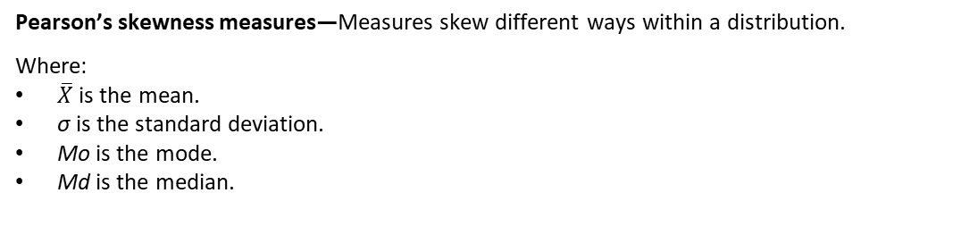

Calculation of Skewness
$${Sk}_{1}=\frac{\overline{X} −Mo}{σ}$$
Pearson’s skewness measures—Measures skew different ways within a distribution.
Where:
$\overline{X}$ is the mean.
σ is the standard deviation.
Mo is the mode.
Md is the median.
$${Sk}_{2}=\frac{3\left(\overline{X} −Md\right)}{σ}$$
Two formulas produce different values, but are interpreted the same way:
The sign of the result identifies the direction of skewness.
Positive value means the peak is shifted to the left.
Negative value means the peak is shifted to the right.
Zero means no skewness at all.
The size of the result represents the degree of skewness from a normal distribution.
Values farther away from zero represent more skewness.
Right-skewed distributions have more data at the lower end, less at the higher end.
Left-skewed distributions have more data at the higher end, less at the lower end.
Both can reveal presence of extreme values on one side compared to the other.

Slide 39
Kurtosis
Leptokurtic
Mesokurtic
Platykurtic
Narrow Peak (Kurtosis > 3)
Normal Peak (Kurtosis = 3)
Flat Peak (Kurtosis < 3)
Heavy tails
Normal tails
Light tails

Slide 40

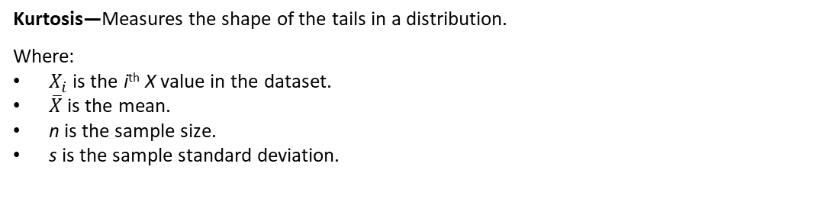
Calculation of Kurtosis
$$a_{4}=\sum{\frac{{\left(X_{i}−\overline{X}\right)}^{4}}{{ns}^{4}}}$$
Kurtosis—Measures the shape of the tails in a distribution.
Where:
$X_{i}$ is the i^{th} X value in the dataset.
$\overline{X}$ is the mean.
n is the sample size.
s is the sample standard deviation.
Measures combined weight of left and right tails relative to the center of distribution.
3 = Mesokurtic—Normal bell-shaped distribution.
<3 = Platykurtic—Bunched to the center, small tails dropping off quickly at sides.
>3 = Leptokurtic—Spread out with extended tails.
Excess kurtosis:
3 is subtracted from the kurtosis result to show a zero for normal (mesokurtic).
Platykurtic distributions would be negative.
Leptokurtic distributions would be positive.
Leptokurtic distributions indicate outliers.
Platykurtic distributions indicate lack of outliers.

Slide 41
Statistical Moments
First moment:
Mean—where numbers typically lie.
Second moment:
Variance—spread or scale of distribution.
Third moment:
Skewness—symmetry of distribution.
Fourth moment:
Kurtosis—flatness or peakedness of distribution.

Slide 42
Guidelines for Exploring the Underlying Distribution of Data
Use histogram, scatter, and other plots to get a sense of the shape of the data.
Look at the distribution of different fields as each may have a different distribution.
Compare standardized distributions and calculated values like skew and kurtosis.
Prefer to use standard deviation over variance when explaining the variability of data.
Ensure measures of central tendency apply to the feature type you're exploring.

Slide 43
Exploring the Underlying Distribution of Data

Slide 44
Use Visualizations to Analyze Data

Slide 45
Visualizations
Represents data in charts that depict patterns, trends, and correlations.
Might otherwise go unnoticed when data is in number/text format.
Can be used at many points in the process.
Including presentation to an audience.
For now, you'll focus on visualization as a means of analyzing data.
Many tools available.
Some are external programs like Excel® or Tableau ®.
Some are internal to a programming language like Matplotlib or ggplot2.
Choice comes down to business needs and comfort level.
Most tools can create the same visualizations.

Slide 46
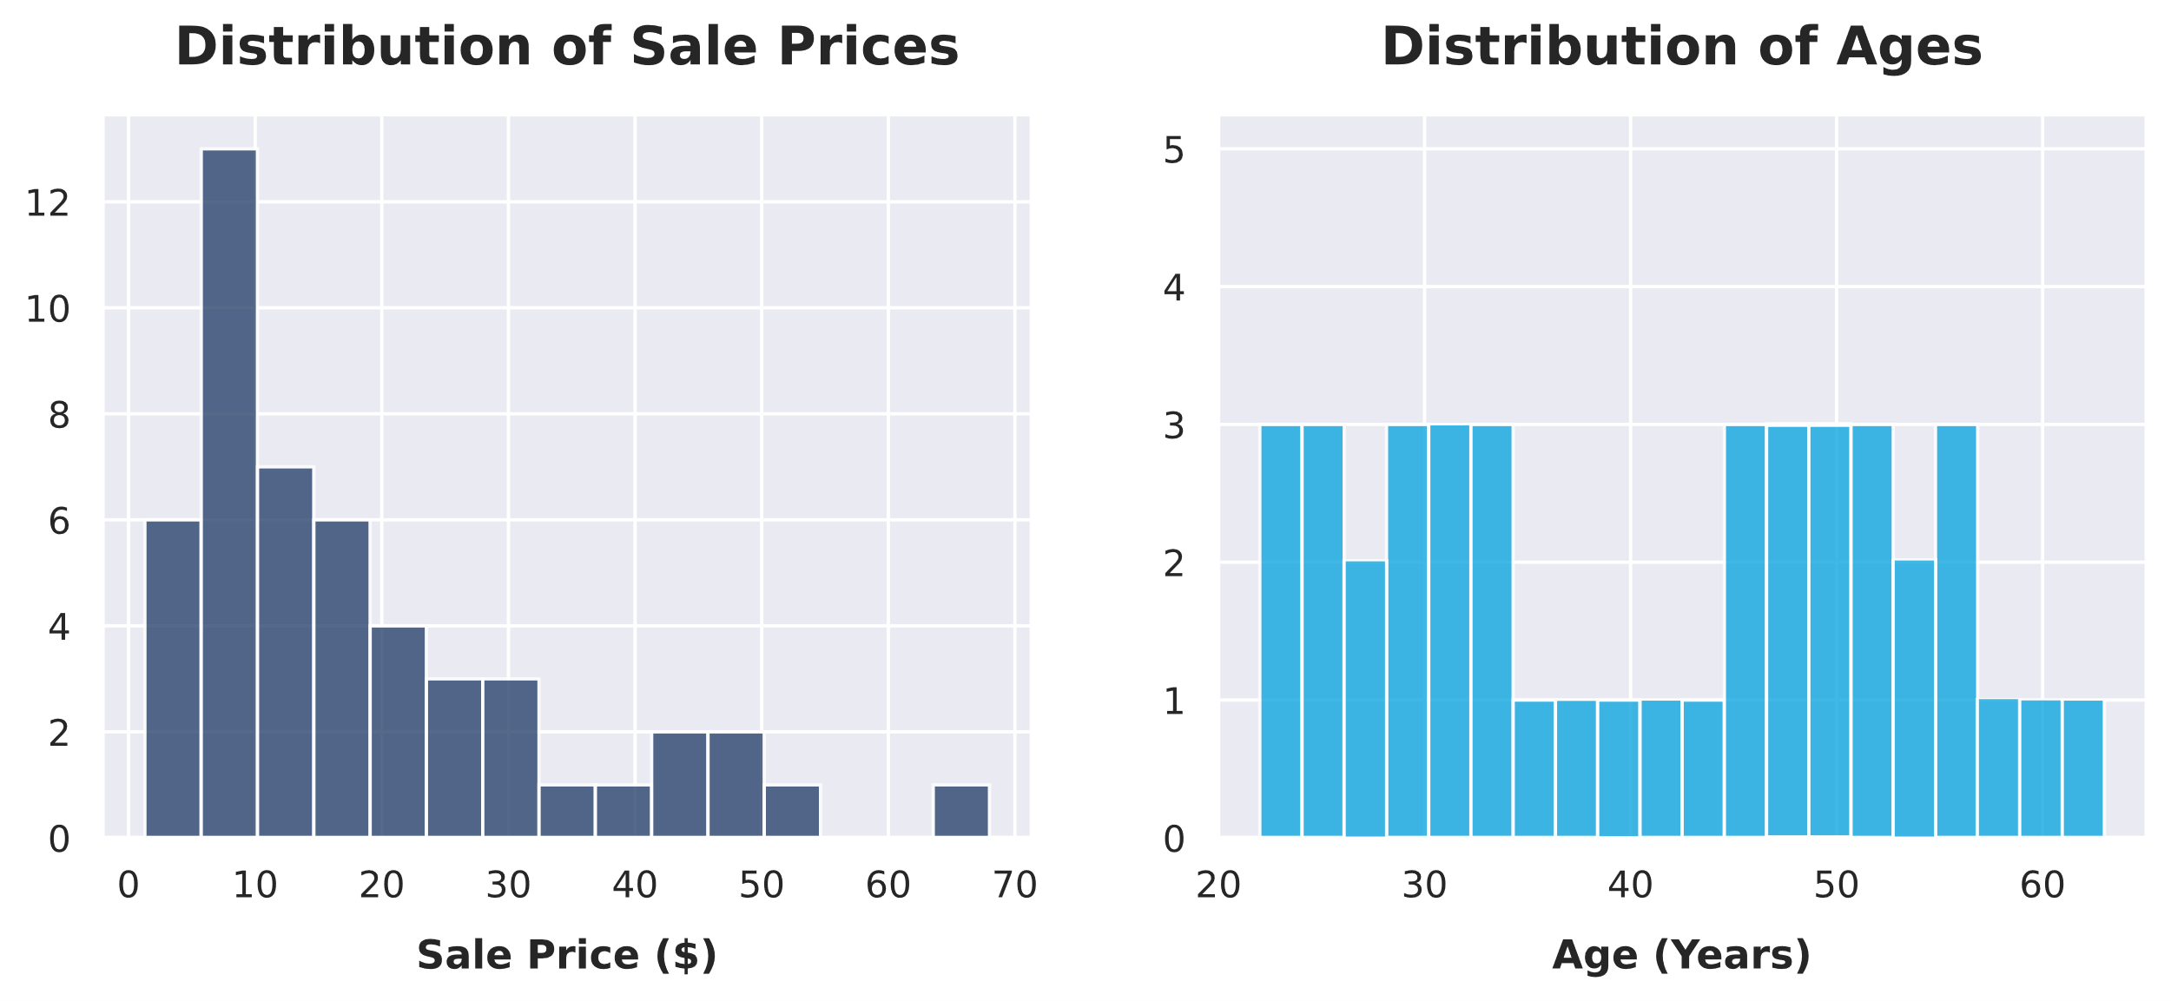
Histograms
Multi-modal distribution
Right-skewed distribution
Bin

Slide 47
Guidelines for Analyzing Data Using Histograms
Use the height of each bin to identify outliers in data.
Manually adjust the number of bins using observation and experimentation.
Plot groups of data on the same chart to identify overlap between those groups.
Use histograms to reveal multimodality in data.

Slide 48
Analyzing Data Using Histograms

Slide 49
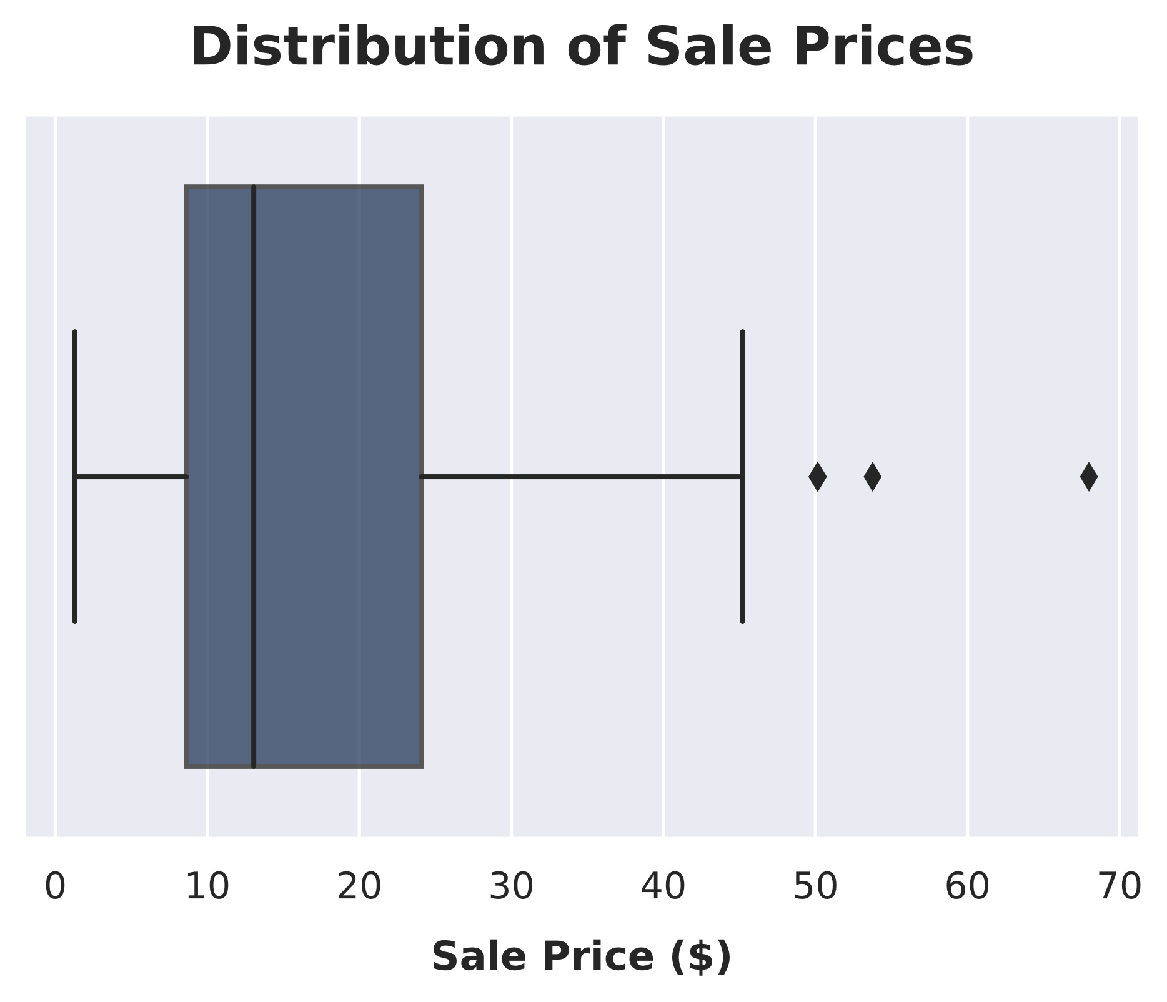
Box Plots
Median
Min
Outlier
Max
Q1
Q3

Slide 50
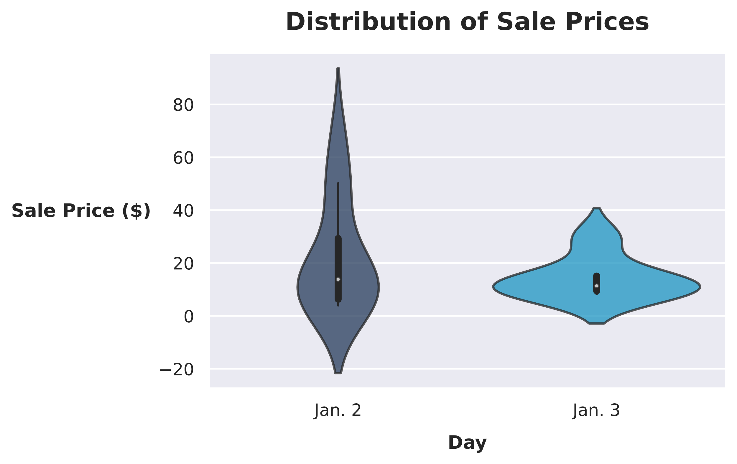
Violin Plot
Low probability
Median
High probability

Slide 51
Guidelines for Analyzing Data Using Box Plots and Violin Plots
Use a series of box plots to show many statistical measures across multiple datasets.
Use violin plots to show value densities that box plots can't show.
Experiment with different colors for each violin plot.
Create violin/box plots when there are multiple datasets to display at once, plotting them on the same axes.

Slide 52
Analyzing Data Using Box Plots and Violin Plots

Slide 53
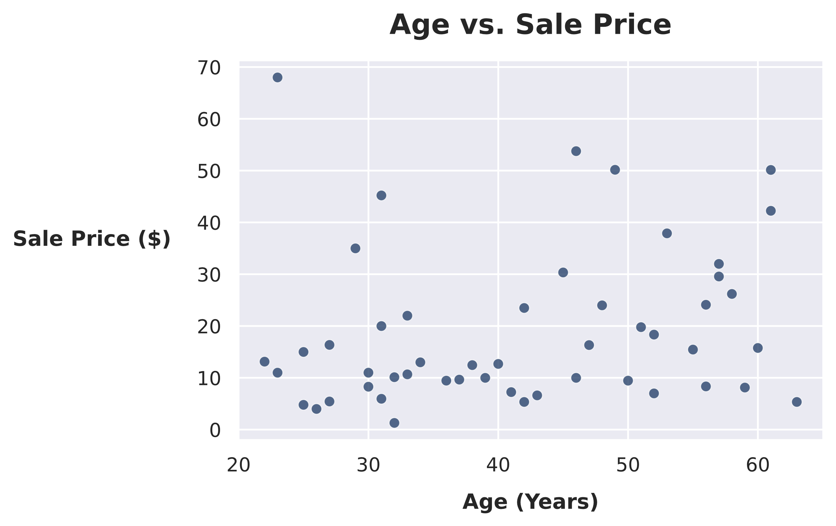
Scatter Plots
Data point
No strong correlation

Slide 54
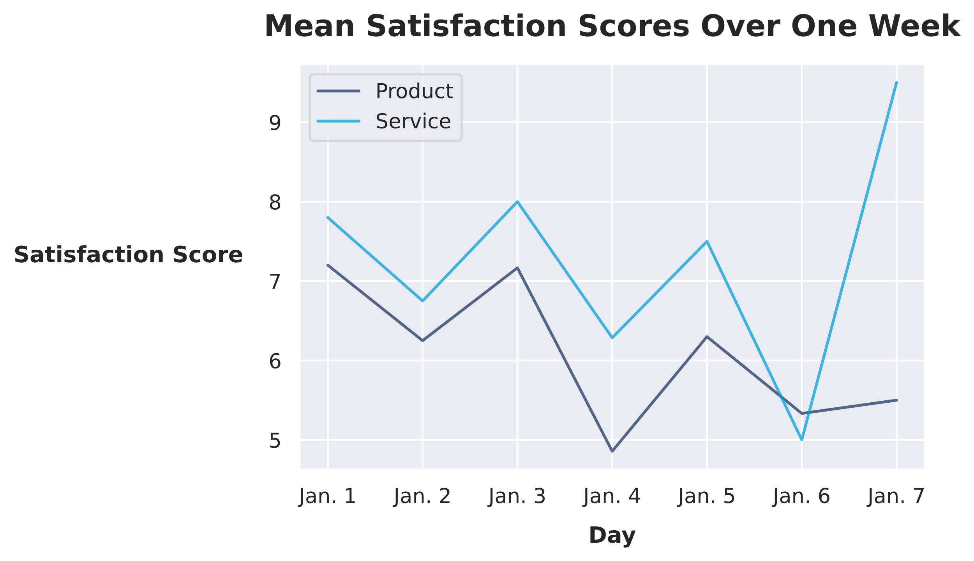
Line Plots
Data point
Trend line

Slide 55
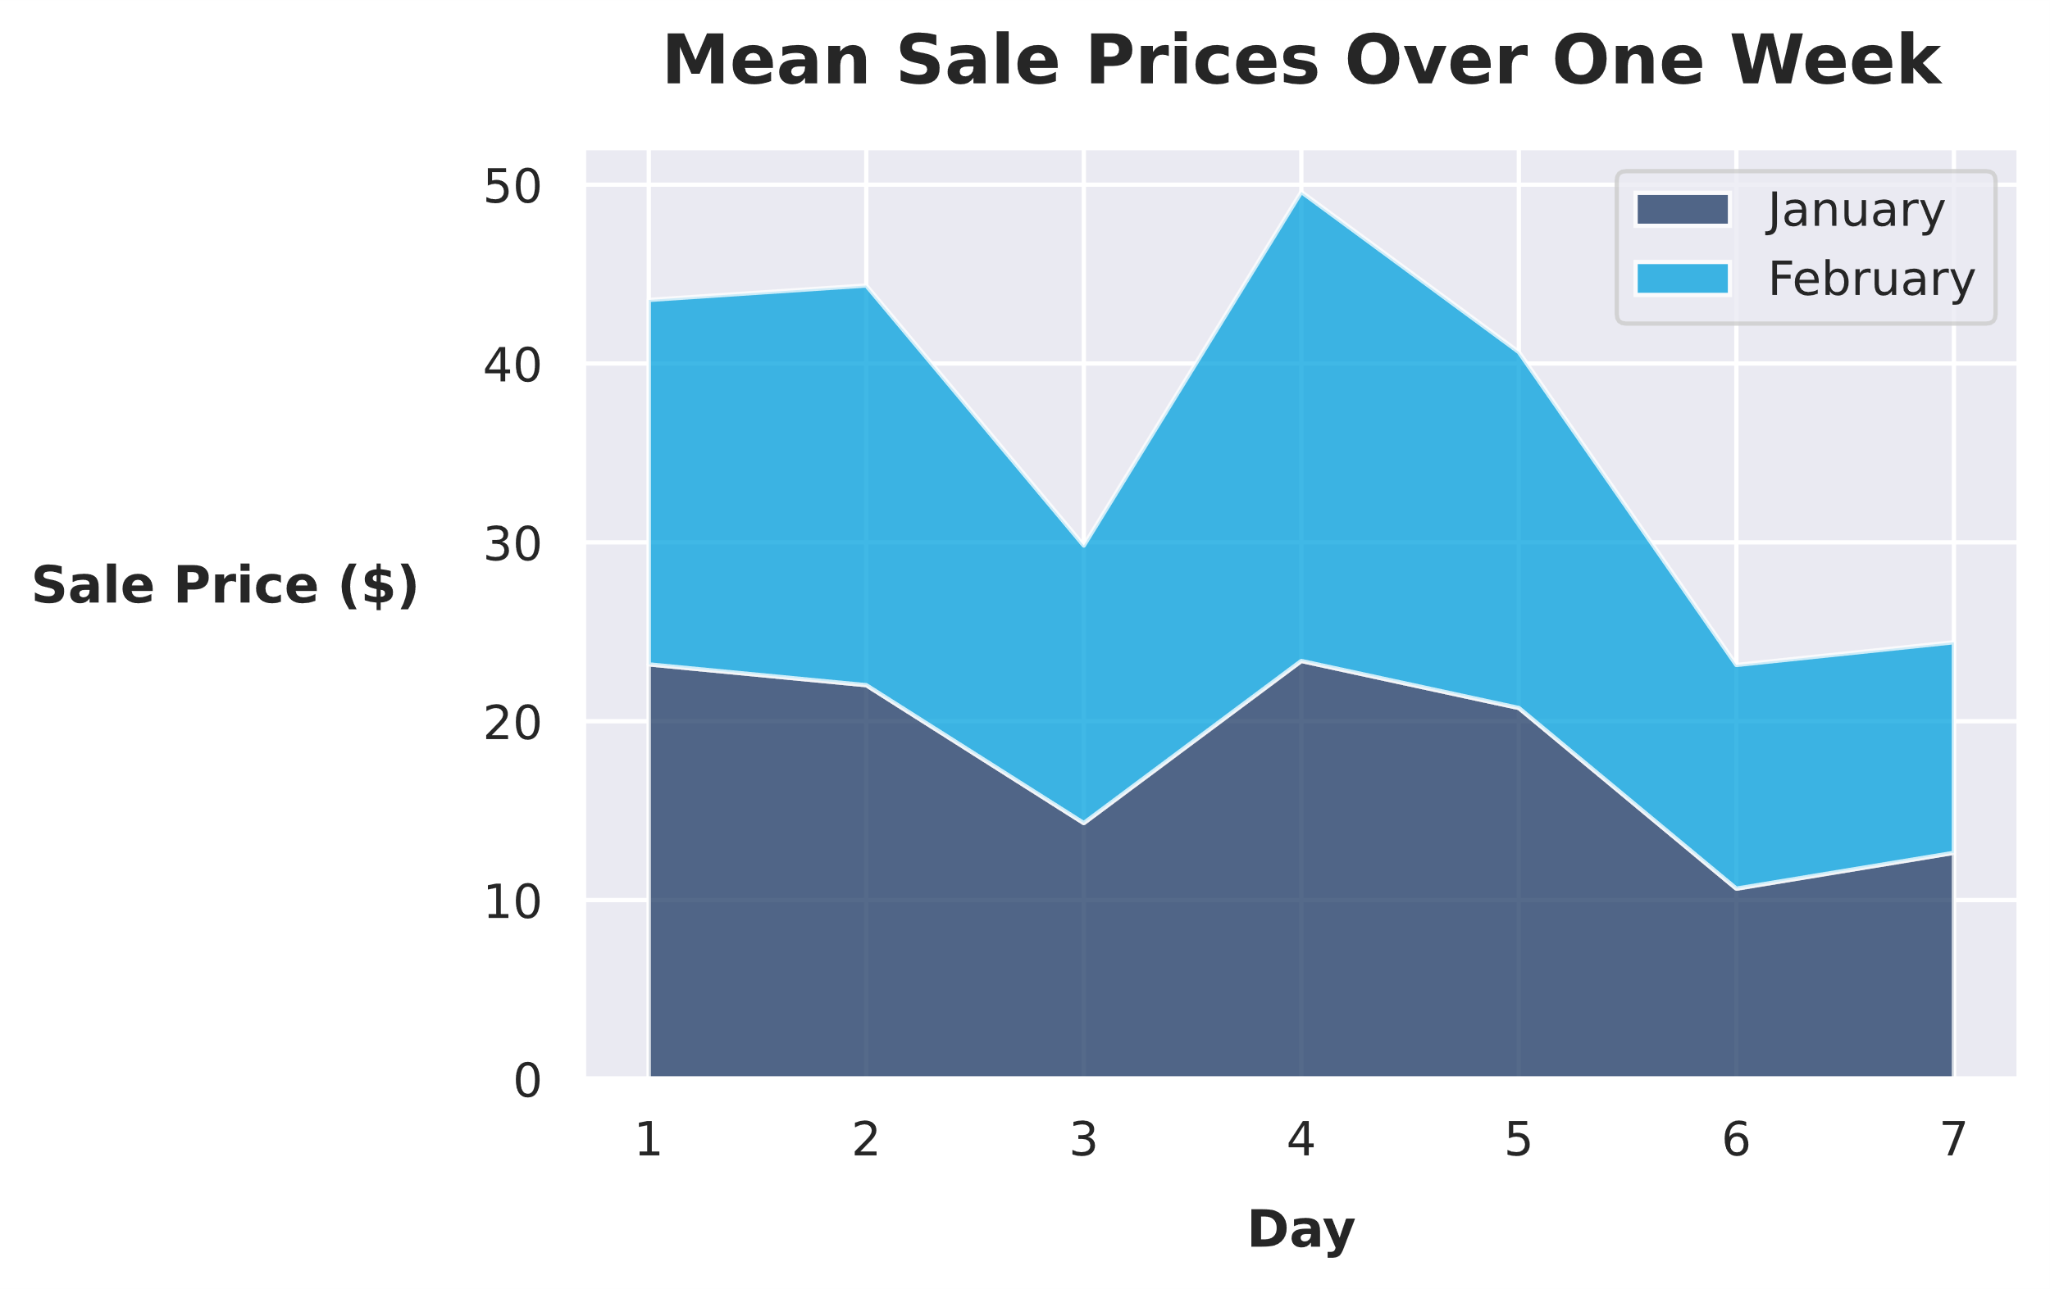
Area Plots
Trend areas

Slide 56
Guidelines for Analyzing Data Using Scatter Plots, Line Plots, and Area Plots
Use labels for important data points only.
Consider using a color and pattern for each line on a line plot.
Use scatter plots where neither axis is categorical data, one of the axes is a time or date, or both axes have irregular intervals.
Use a line plot when one axis represents time or date.
Consider an area plot when multiple aspects of data need to be shown.
Plot the largest area first so that the smallest area is not obscured by other plots.

Slide 57
Analyzing Data Using Scatter Plots and Line Plots

Slide 58
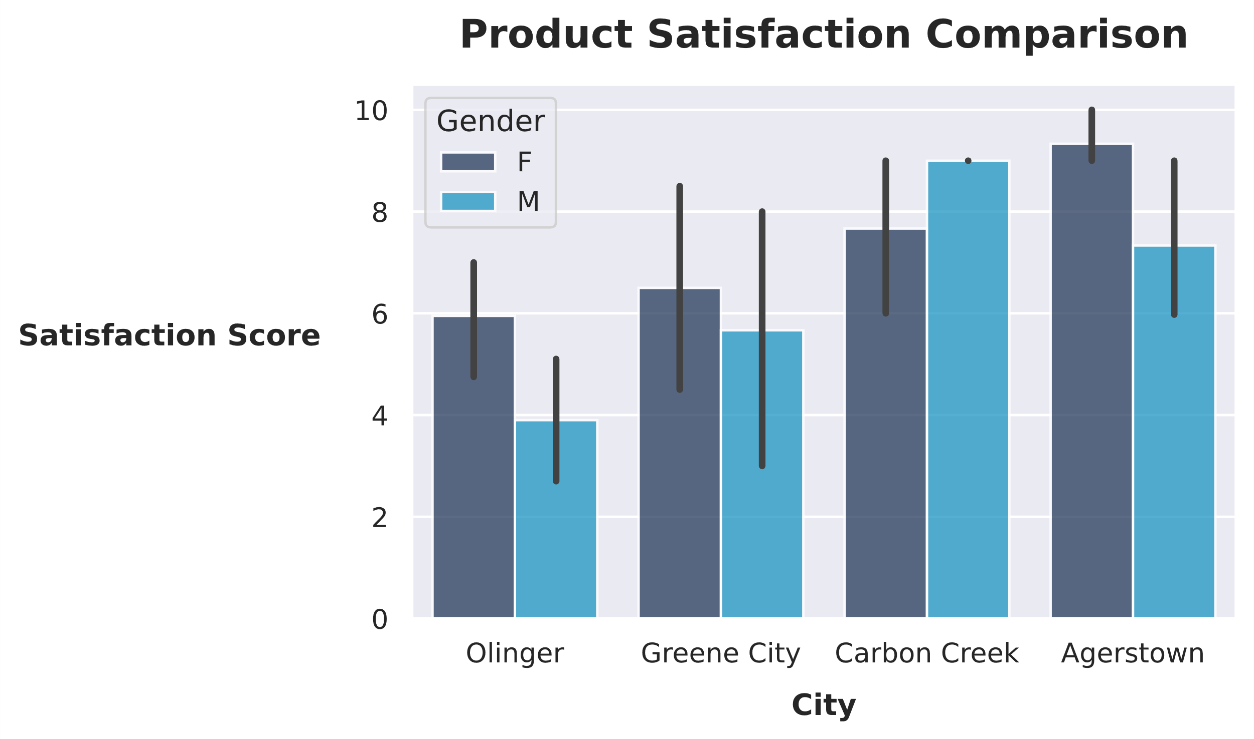
Bar Charts
Mean
Error bar

Slide 59
Guidelines for Analyzing Data Using Bar Charts
Use bar charts when at least one axis is categorical data or discrete data at regular intervals.
Consider using bar charts when one of the axes has around twenty or fewer values.
Show multiple data sources on a bar chart if they share common categories.
Use one color per dataset when displaying multiple datasets.
Order bars from highest to lowest when there is no inherent ordering of the categories.

Slide 60
Analyzing Data Using Bar Charts

Slide 61
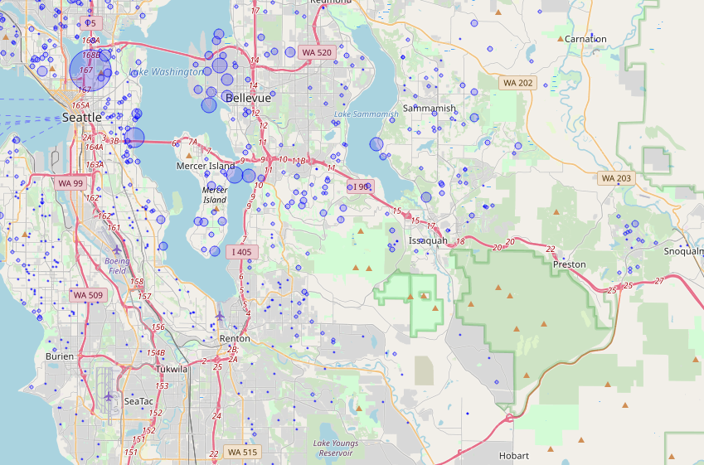
Geographical Maps
Most expensive homes
Less expensive homes

Slide 62
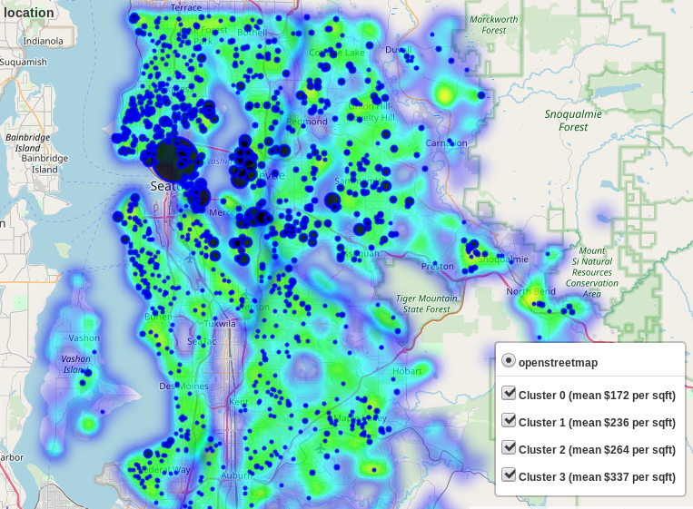
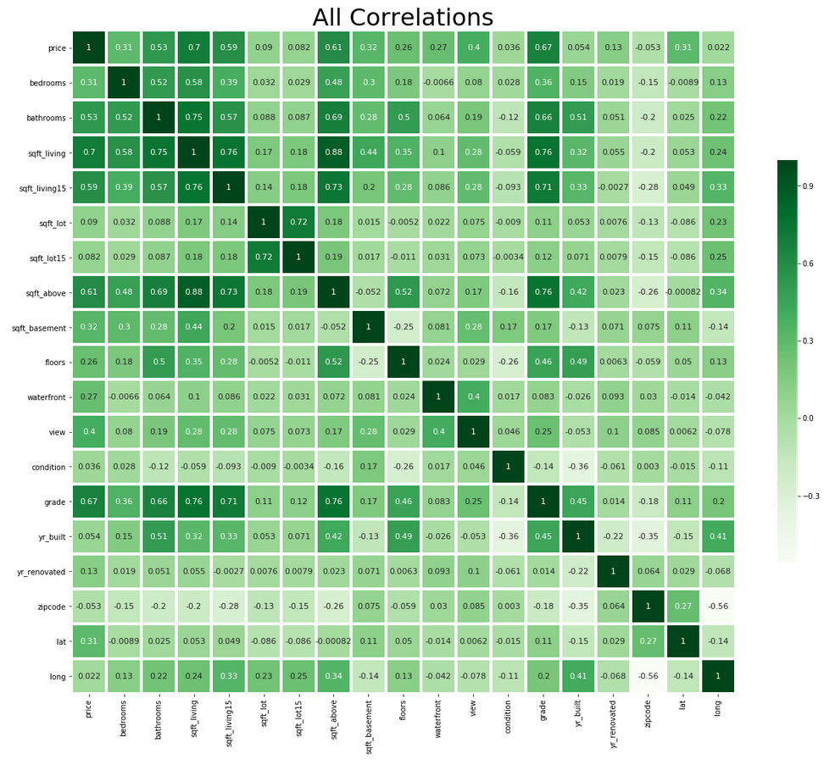
Heatmaps
Heatmap superimposed on a geographical map
Areas with fewer houses are shown in purple. Areas with more houses are shown in green.
Correlation matrix shown in a heatmap
Data pairs with lower correlation are shown in lighter shades. Data pairs with higher correlation are shown in darker shades.

Slide 63
Guidelines for Analyzing Data Using Maps
Consider overlaying data on a topographical map when the data corresponds to physical features.
Avoid using too many colors or too many data overlays.
Add features to pan and zoom or add/remove data layers.
Use gradients that make sense for the data being displayed.
Add major cities and geographical landmarks to help users orient themselves.
Use maps that relate to the data being presented, not as a background.

Slide 64
Analyzing Data Using Maps

Slide 65
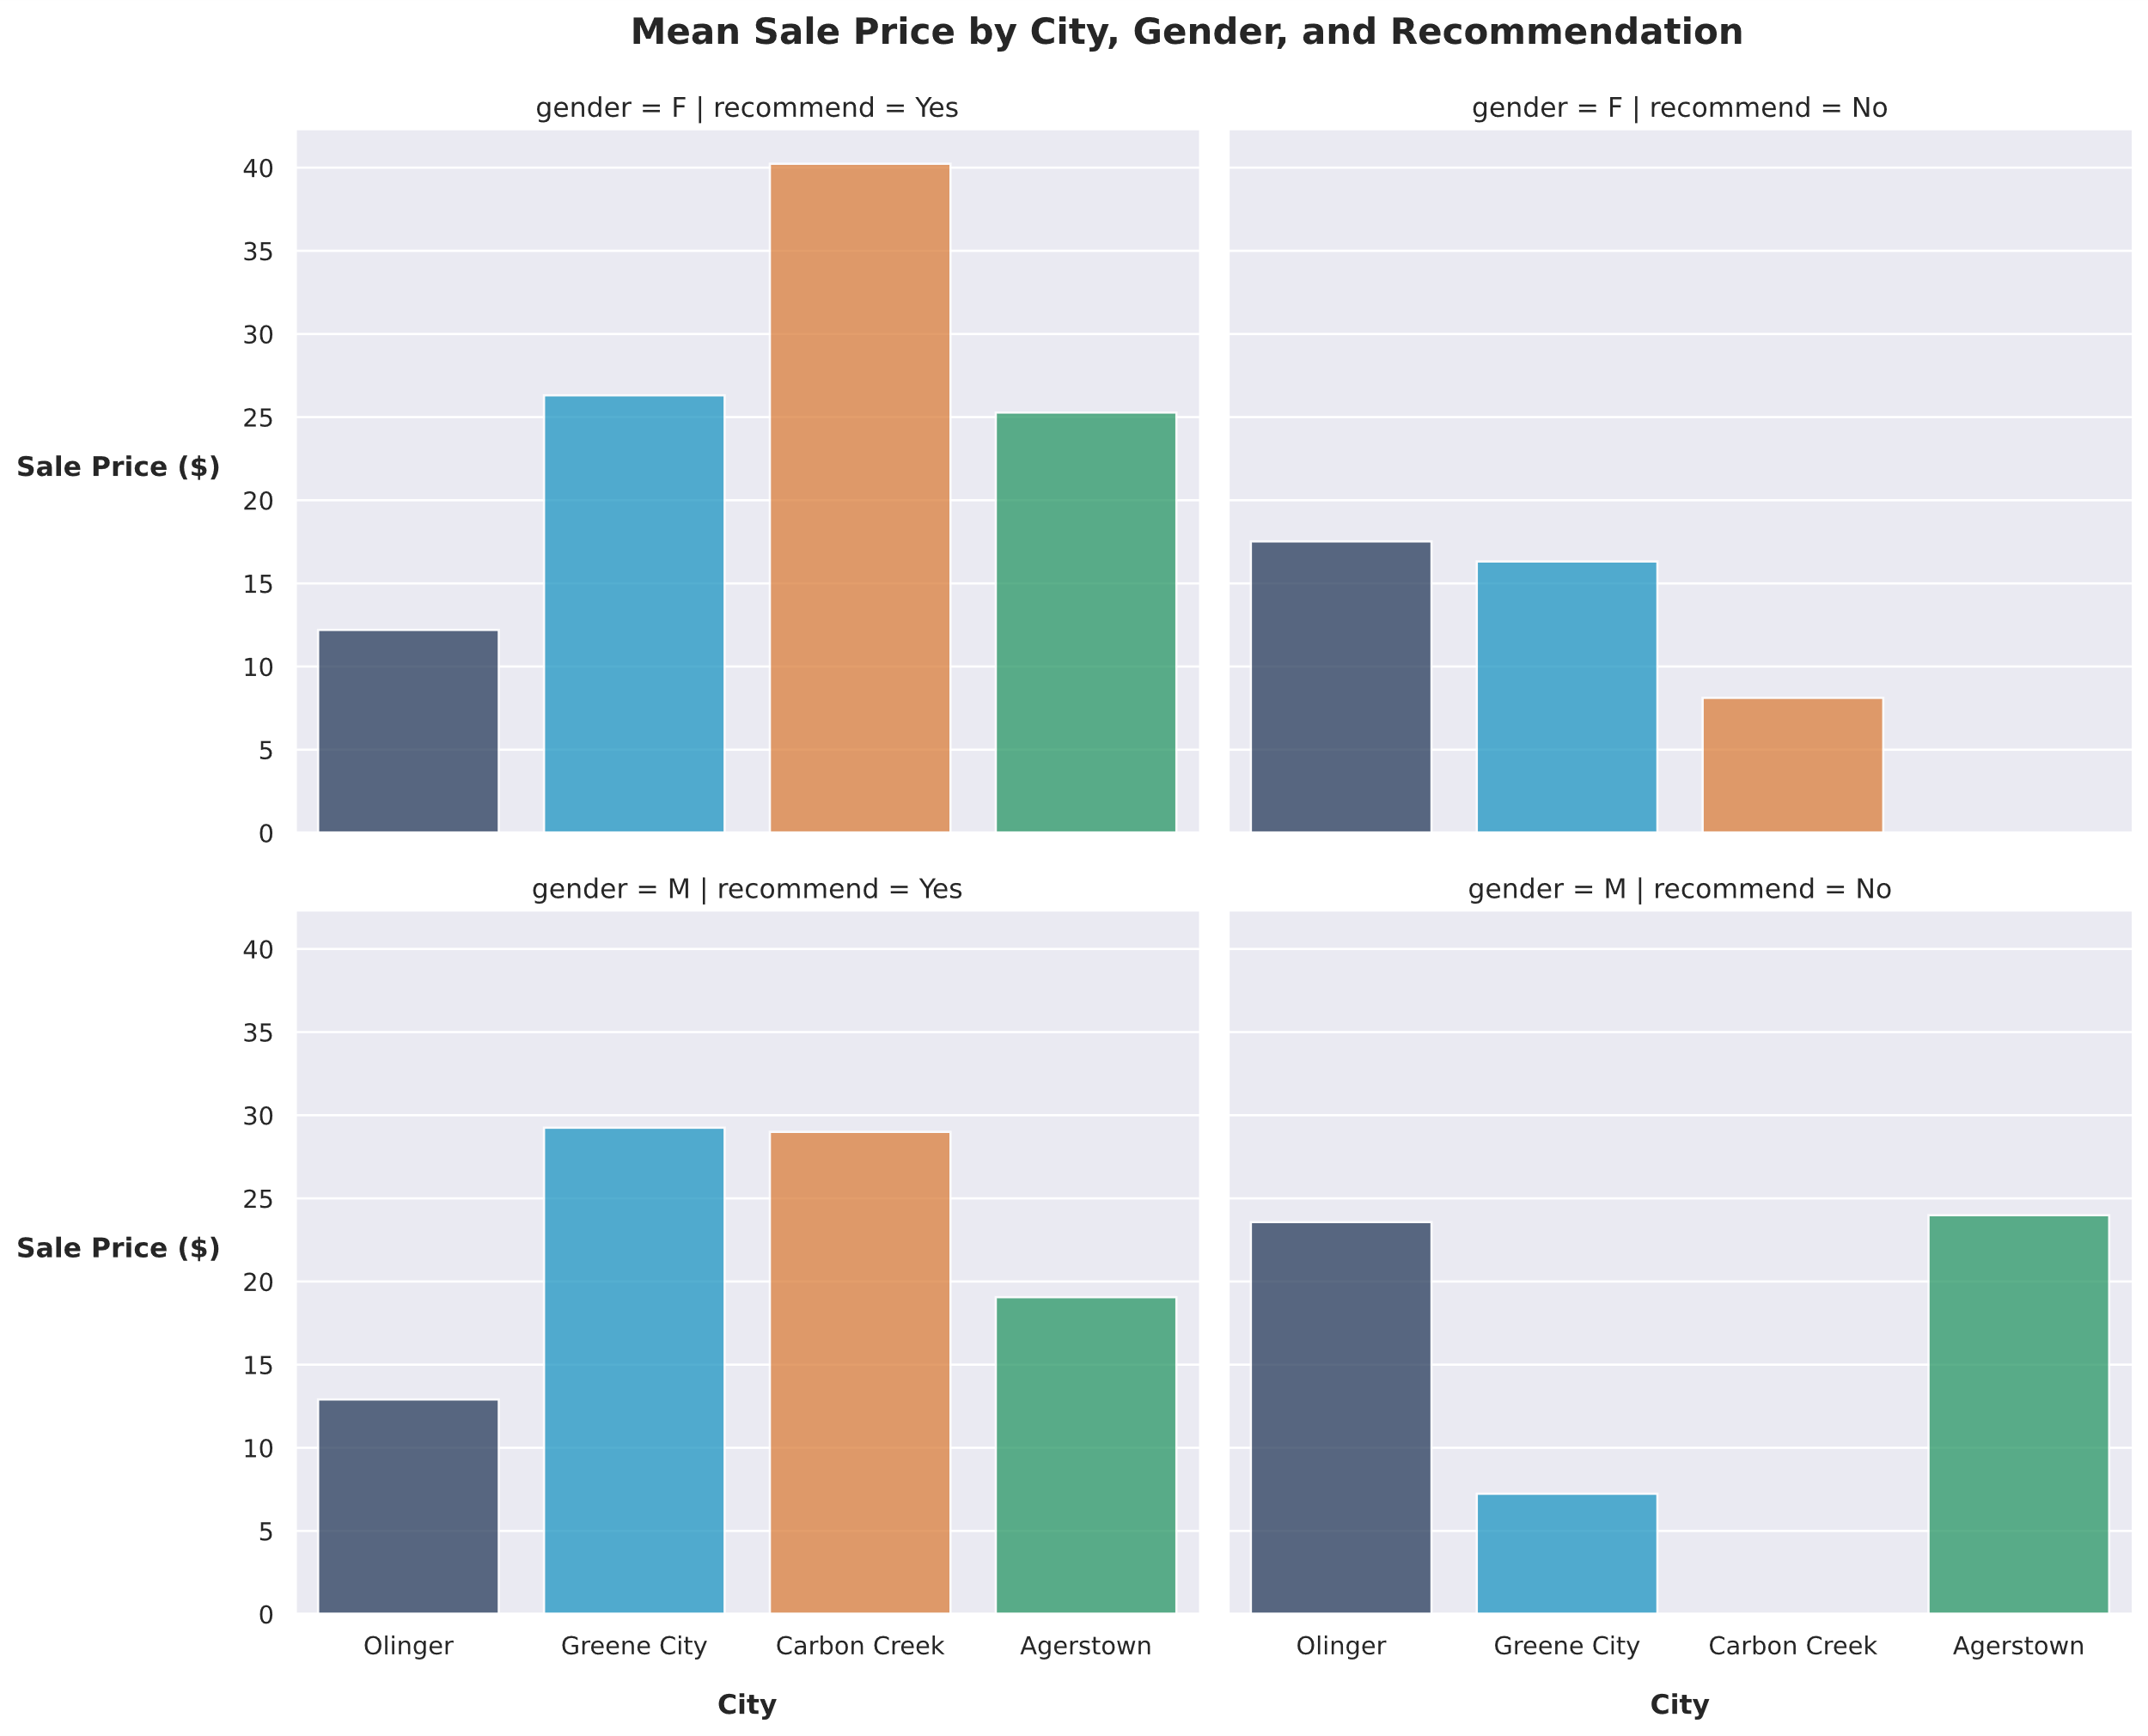
Plots in Combination (Bar Chart Grid)
Female
Male
Recommender
Non-recommender

Slide 66
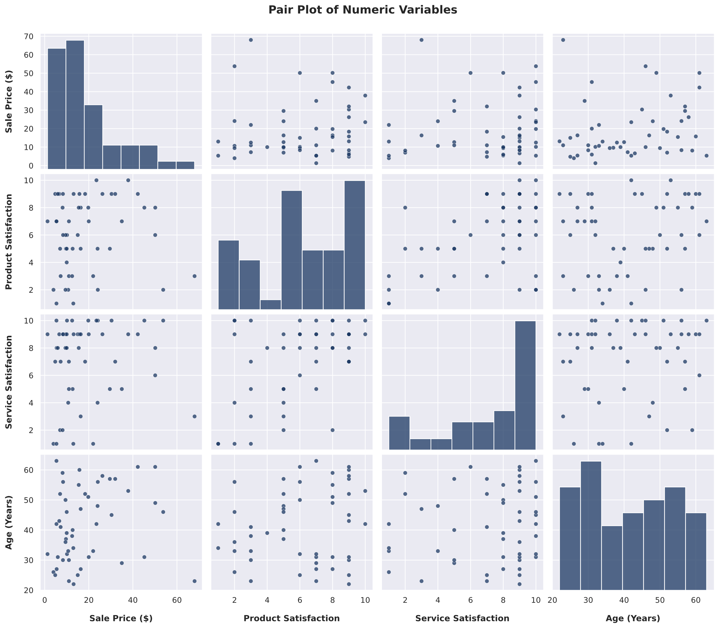
Plots in Combination (Pair Plot)
Sale Price compared to other variables
Sale Price distribution

Slide 67
Guidelines for Using Visualizations to Analyze Data
Be mindful of the story you are trying to tell with your data.
Include axis labels, titles, and data legends.
Scale axes appropriately with major and minor tick marks.
Avoid adding too much data that ends up being distracting.
Generate enough visualizations that are necessary for revealing important patterns and ideas.

Slide 68
Comparing Visual Analysis Methods

Slide 69
Preprocess Data

Slide 70

You Are Here (Process and Analyze)
Frame the Problem
Identify & Collect Data
Process Data
Analyze Data
Finalize the Project
Train Models

Slide 71
Data Analysis Prompts Further Transformation
ETL process is not linear, but iterative.
The challenge is: What's the best way to improve the data?
Some transformations are obvious early in the process.
But you will likely need to make multiple transformation passes.
You need to explore and analyze your data to know how best to improve it.
Examples:
Skewed distributions prompting you to normalize variables.
Lack of correlations prompting you to drop a feature.
Plots revealing outliers that you remove.
You'll usually make changes, analyze them, make more changes, and so on.
The process ends when you're satisfied with the results.

Slide 72
Data Preprocessing
Data preprocessing: The task of transforming data so that it can be interpreted and analyzed by machine learning algorithms.
Data is prepared, similar to how ETL prepares data earlier.
Most preliminary transformation is already done.
Focuses on facilitating machine learning.
Machine learning algorithms have unique challenges and requirements.
Data must accommodate them.
Preprocessing techniques:
Handling missing values.
Scaling variables.
Removing unnecessary/unhelpful features.
Engineering new features.

Slide 73
Identification of Missing Values
Student ID | Last Name | First Name | Test Score
0001 | Ferard | Catherine | 98.5
0002 | Murphy | Jeremy
0003 | Haverson | Maria | 75.5
Jeremy Murphy's test score is missing.
Measuring the feature may fail.
Each language/library handles missing values differently.
pandas would pull that missing value in as NaN (a float).
NA is another type of null, though currently experimental.
Many libraries provide functions that automatically detect nulls.
Look for presence of NaN and then return any.
Not all missing data is cast as a recognizable null type.
Function to identify nulls won't work if the missing value is unusual or non-standard.
E.g., a string like '?'

Slide 74
Imputation of Missing Values
You should actively decide how to handle missing values.
Sometimes models can cope with missing values, other times not.
You may drop entire records with missing values, but this can reduce effectiveness.
Imputation fills in missing values using best estimates.
Method | Description
Mean/mode imputation | Calculates mean or mode of all non-missing items from the same column that the missing value is in.
Substitution | Uses data from a new record that is not already in the sample.
Hot deck imputation | Finds records in the sample that have similar values for everything except what's missing, then copy the value in question to fill the missing value.
Cold deck imputation | Same as hot deck, but pulls data from an external sample.
Regression imputation | Creates a machine learning model to predict the missing value given patterns in the data.

Slide 75
Guidelines for Handling Missing Values
Recognize if the model/algorithm being used is tolerant of some missing data.
Replace missing data in continuous values with an average, zero, min, or max depending on its characteristics.
Replace missing category data with the most frequently occurring category.
Create a new "missing" category if many records are missing a category.
Consider removing a record if there are a number of variables missing.
Drop columns missing values for at least 70% of the records.
When working with an ordered series:
Fill in missing records at the start of the series by carrying back the first data available.
Fill in missing records at the end of the series by carrying the last data point forward.

Slide 76
Handling Missing Values

Slide 77
Feature Scaling
Algorithms find patterns in data using different approaches.
The distribution of data is sometimes the most important factor.
Scaling functions transform numeric variables to emphasize distribution.
De-emphasizes magnitude of values.
Important for distance-based algorithms.
Less important for tree-based algorithms.
Example features: miles_driven and years_old
Former can extend into the hundreds of thousands.
Latter only extends into the tens.
Both are equally useful for predicting a car's value.
Algorithms might treat the former as being more important.
You need to scale them so that their distributions are emphasized.

Slide 78
Normalization and Standardization
Normalization:
Transforms a feature so lowest value is 0 and highest is 1.
Algorithm sees miles_driven and years_old on the same scale.
Useful with algorithms that don't assume any specific distribution.
Good at minimizing effect of outliers.
Standardization:
Calculates z-score (number of standard deviations above or below mean of all values).
Results in a feature with a mean of 0 and a standard deviation of 1.
Useful for data that is already normally distributed.
Doesn't minimize outliers in the same way.
One approach isn't always better than the other.
Experiment with both.

Slide 79
Additional Transformation Functions
Function | Description
Log | Calculates log base 10 of x, log base e of x, or log base 2 of x. Reduces positive skewness. Can only be used on positive numbers.
Cube root | Raises x to a power of 1 / 3. Reduces positive skewness. Not as strong as log, but can handle zero and negative numbers.
Box–Cox | Raises x to a power of λ, subtracts 1, then divides result by λ. Calculation happens for all values of λ until data approximates normal distribution. If λ is 0, log of x is taken. Reduces skewness and obtains normally distributed data. Leverages both log and power transformations. Has a version that can handle negative numbers.

Slide 80
Guidelines for Applying Transformation Functions to Datasets
Test different transformations with the model or algorithm used.
Recognize if transformations are required for the model or algorithm used.
Use normalization when different variables need to be between a given range.
Use standardization to preserve distributions when comparing variables with very different scales.

Slide 81
Applying Transformation Functions to a Dataset

Slide 82
Feature Engineering
Feature engineering: The technique of generating features from data in order to improve machine learning models.
You don't necessarily have the best possible features for the job.
You can create new, more useful features.
Will be better at solving your given problem.
Feature engineering involves:
Encoding categorical data.
Binning continuous variables.
Splitting features.
Selecting and extracting features.
Ensure you've already handled missing values and deduplicated data first.
Also remove any redundant or non-estimative features before creating new ones.

Slide 83
Data Encoding
Data encoding: The process of converting data of a certain type into a coded value of a different type.
Usually takes a string of text and converts it into a number.
Resulting number becomes a new feature.
Original feature is removed or ignored.
Many algorithms can't handle categorical data as strings, so encoding is important.
Example: city has ['Berlin', 'London', 'Rochester'] as possible values.
You wouldn't feed these strings directly into an algorithm.
Convert them to numbers first.
Resulting features are still categorical, despite using numbers.

Slide 84
Data Encoding Methods (Slide 1 of 2)
Method | Description
Label | Each value in a label category becomes a number. city_encoded becomes [0, 1, 2]. Implies a sequence/rank; not suitable for non-ordinal categories.
One-hot | Creates dummy column for each category. isBerlin, isLondon, isRochester. 1 implies presence, 0 implies absence. Non-ordinal.
Binary | Converts category to ordinal integer, then to a binary digit. Each digit is a new column. Loses some info, but is more efficient than one-hot.

Slide 85
Data Encoding Methods (Slide 2 of 2)
Method | Description
Effect | Similar to binary, but values are either −1, 0, or 1. Advanced and less common.
Frequency | Calculates frequency of each category, uses this number as the code. Adds a weighting component.
Target mean | Code is a function of the mean of the target variable. Target must be numeric, encoded variable is categorical.
Hash | Maps text string to an algorithmically determined number. Used to generate consistent codes when there are many categories.
Base-N | Base-1 is same as one-hot; Base-2 is same as binary. No additional advantages.

Slide 86
Guidelines for Encoding Data
Use integers when assigning labels or categories to discrete non-continuous values.
Convert categories with an inherent, natural ordering to a sequence using ordinals.
Maintain a lookup table to generate the category names from the values.
Use one-hot encoding when an algorithm calls for a vector of categories for each record.
Consider hashing labels when there are a large number (100+) of categories in order to reduce the number of categories.

Slide 87
Encoding Data

Slide 88
Continuous Variable Discretization
Continuous variables are uncountable, discrete are countable.
No defined gaps vs. well-defined gaps.
Algorithms like decision trees can't handle continuous variables.
Will just keep splitting over and over again, becoming too large and inefficient.
Discretization is the process of engineering discrete features from continuous ones.
Can simplify and improve a model.
Binning is the primary method of discretization.
Places continuous variable into specific, discrete intervals called "bins."
Example: Marathon Time in Minutes
Fastest runner finished in 120 minutes, slowest in 600 minutes.
You could place them into 480 different bins, one for each minute.

Slide 89
Bin Determination
Select the number of bins as well as the range between each bin (width).
Choice depends on size of dataset.
5 or more is common for thousands of records.
20+ bins is usually too many.
Time in Hours will give you 8 bins.
As number of bins increases, model complexity increases.
Binning leads to some information loss.
Equal-width binning:
Each bin spans same range of values.
With 8 bins from 120 to 600 minutes, each bin has a range of 60 minutes.
Sensitive to outliers, and leads to higher information loss.
Equal-frequency binning:
Each bin contains same number values.
Distribution of values is taken into account.
Minimizes information loss, and less sensitive to outliers.
In supervised learning, binning complexity is justified with the stronger relationship between a feature and the label.
In unsupervised learning, you must use a feature's distribution to determine bins.

Slide 90
Guidelines for Discretizing Variables
Convert continuous variables to discrete ordinals for algorithms that cannot handle discrete data or that train faster with a limited number of ordinals for a variable.
Determine how many bins are required based on the use of the data.
Use a uniform distribution when the shape and other characteristics of the distribution should be preserved.
Choose a quantile distribution with the same number of samples in each bin when favored by the algorithm being used.
Recognize that the loss in precision is often offset by the gain in training speed and/or performance of a model.

Slide 91
Discretizing Variables

Slide 92
Feature Splitting
You may want to split one feature into multiple.
Example: name is 'Emily Williams'
Might be worth splitting into first and last name.
Model can learn from both independently.
Common with text-based data like names, locations, identifiers, titles.
Choice of splitting comes down to domain knowledge but consider experimenting.
split() divides based on a separator like whitespace.
Produces ['Emily', 'Williams']
strip() removes leading and trailing whitespace.
Extract middle of a string.
reverse() reverses a list.
['Williams', 'Emily'] becomes ['Emily', 'Williams']
You can also split date and time values.
Much easier if they're in datetime format.
If not, you can use a string splitting function.

Slide 93
Guidelines for Splitting Features
Split on punctuation if available in the field.
Split on whitespace only when data has regular patterns and each split item does not have embedded spaces.
Use regex when the data format is predictable but doesn't have delimiters.
Take advantage of case differences, embedded numbers, punctuation, and other features when using regex.
Retain only the new fields that are required.
Process features after splitting by cleaning up or applying transformation functions again as necessary.

Slide 94
Splitting and Removing Features

Slide 95
Dimensionality Reduction
Curse of dimensionality:
Adding more features won't always improve a model.
Especially if number of data examples stays the same.
Features can be redundant or noisy for learning purposes.
Model will actually start to degrade if enough features are added.
Dimensionality reduction simplifies a dataset.
Feature selection:
Selects a subset of original features.
Includes most relevant, excludes most irrelevant.
Useful when there are many more features than examples.
Feature extraction:
Derives new features from original features.
Combines multiple correlated features into one.
Useful in computer vision applications.
Dimensionality reduction is almost always worth doing.

Slide 96
Dimensionality Reduction Methods (Slide 1 of 2)
Method | Description
PCA | Data in higher dimensions is projected into equal or lower dimensions. Selects features that contribute most to linear variance, drops rest.
SVD | Decomposes matrices of features to select best subset. Can be implemented by PCA. Works well with sparse matrices.
t-SNE | Generates probability distributions of data pairs in higher dimensions. Repeats process for lower dimensions until divergence is minimized. Can retain non-linear variance.
Random forest | Reveals which features have largest influence on model estimations. Higher weight percentages indicate more important features.

Slide 97
Dimensionality Reduction Methods (Slide 2 of 2)
Method | Description
Forward feature selection | Model starts with no features. Features added iteratively until improvements stop.
Backward feature elimination | Model starts with all features. Features removed iteratively until improvements stop.
Factor analysis | Measures latent variables through relationship between observable variables. Latent variables are selected as new features.
Missing value ratio | Removes features with total number of missing values that exceed a threshold. Missing features can impair model performance.
Low-variance filter | Removes features with variance lower than a threshold. Lack of variance doesn't help a model learn.
High-correlation filter | Removes one feature from a pair if correlation coefficient exceeds a threshold. Highly correlated features may be redundant.

Slide 98
Guidelines for Performing Dimensionality Reduction
Remove a variable that has a high correlation with another variable.
Or, join multiple variables that are closely correlated into a single variable.
Review the impact to results of removed or reduced variables.
Try different methods of dimensionality reduction for a collection of variables.

Slide 99
Performing Dimensionality Reduction

Slide 100
Guidelines for Preprocessing Data
Automate as much of the process as possible.
Create scripts early in the process to verify the design decisions made.
Rerun models and compare with prior executions of the same data.
Consider using a single integrated platform for initial investigations.
Allocate a generous amount of time when automating a manual process.
Consider implementing diagnostic and error reporting for automated processes.
Recognize that feature engineering decisions will need to be revisited when results are analyzed or new data is received.
Review data retention policies and identify how long data will need to be stored for verification or modeling.
Store versions or snapshots of code, programs, workbooks, or workbenches used in modeling.

Slide 101
Comparing Data Preprocessing Techniques

Slide 102
What types of target variables do you think you'll be most interested in exploring in your own projects?
What kinds of data visualizations do you think you'll create most often on the job?

